Slide 1
C#
(See~ Sharp! )
An autonomous pencil sharpening robot
Group 13
Eugne Wang, Felix Cheng, Feilan Jiang, Kenta Morris

Slide 2
Presentation Outline
Design Problem Definition
Criteria and Constraint
Proposed Mechanical Design
Verification of design/specification
Notes:
COVER FOR NO MORE THAN 5 SECONDS

Slide 3

Design Problem Definition
Artists are inconvenienced by the need to sharpen and sort the large amount of pencils needed for their projects.
Help artists sharpen and sort their pencils efficiently

Slide 4
Criteria & Constraints

Slide 5
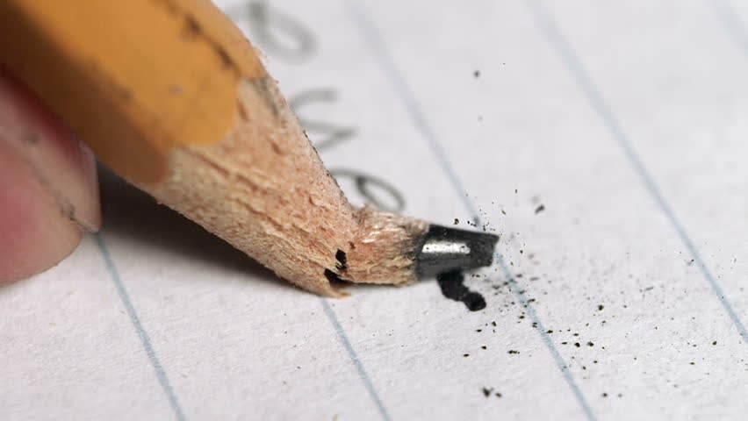

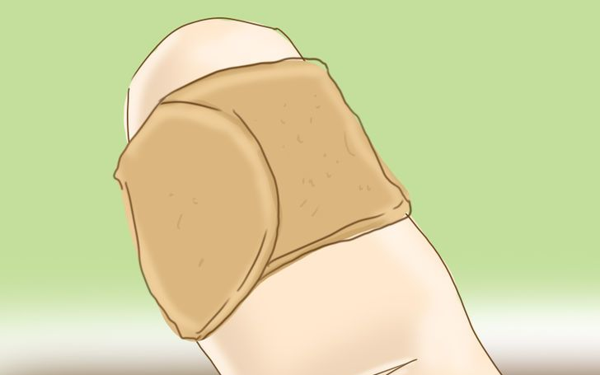
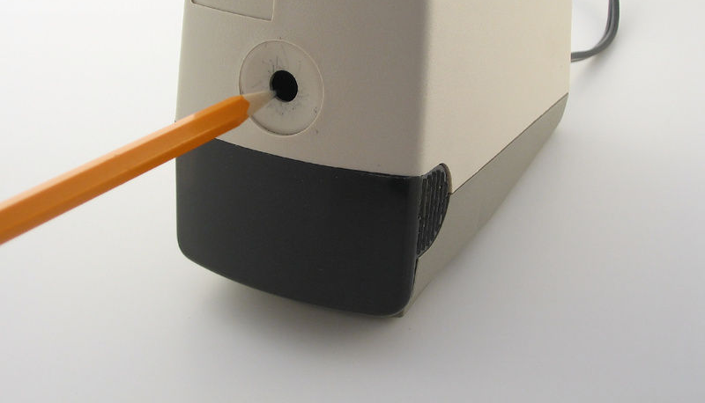
Constraints:
Must not chip or break sharpened pencils
Must be stable to stand by itself
Must include physical guard to protect users’ fingers.
Must sort pencils by colour

Slide 6
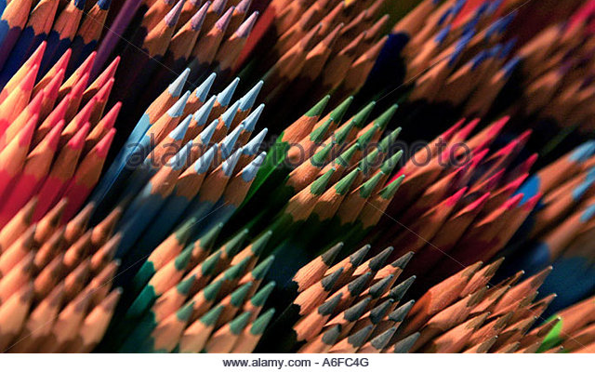
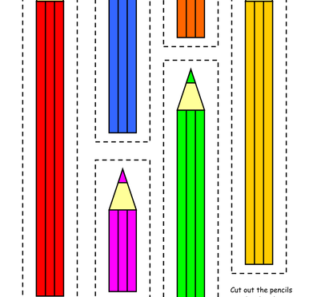

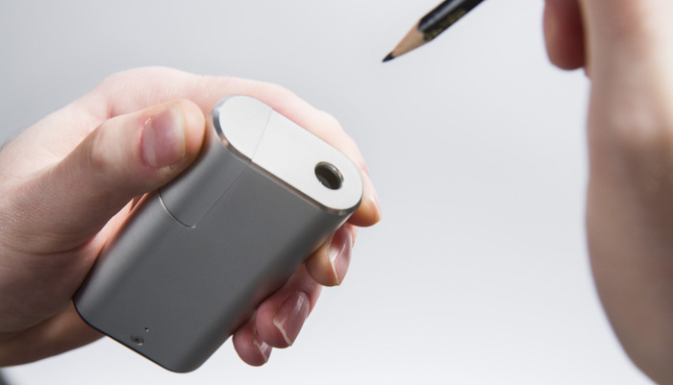
Criteria
Accommodates various pencil sizes
Sorts pencils according to different criteria as needed
Is portable (can be moved by one person)
Container for sorted pencils is easily removed and replaced

Slide 7
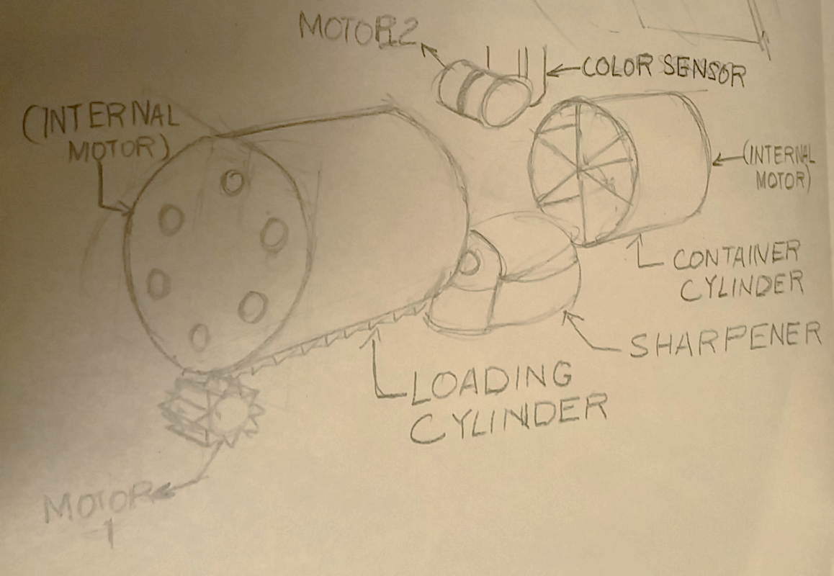
Preliminary Design 1
4
5
3
1
2

Slide 8
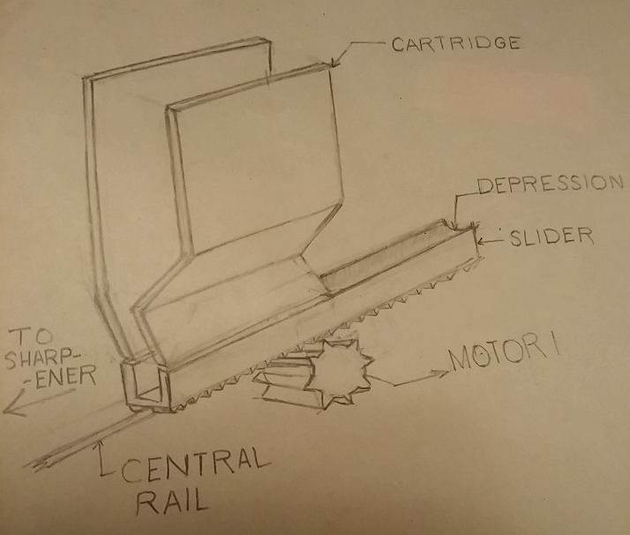
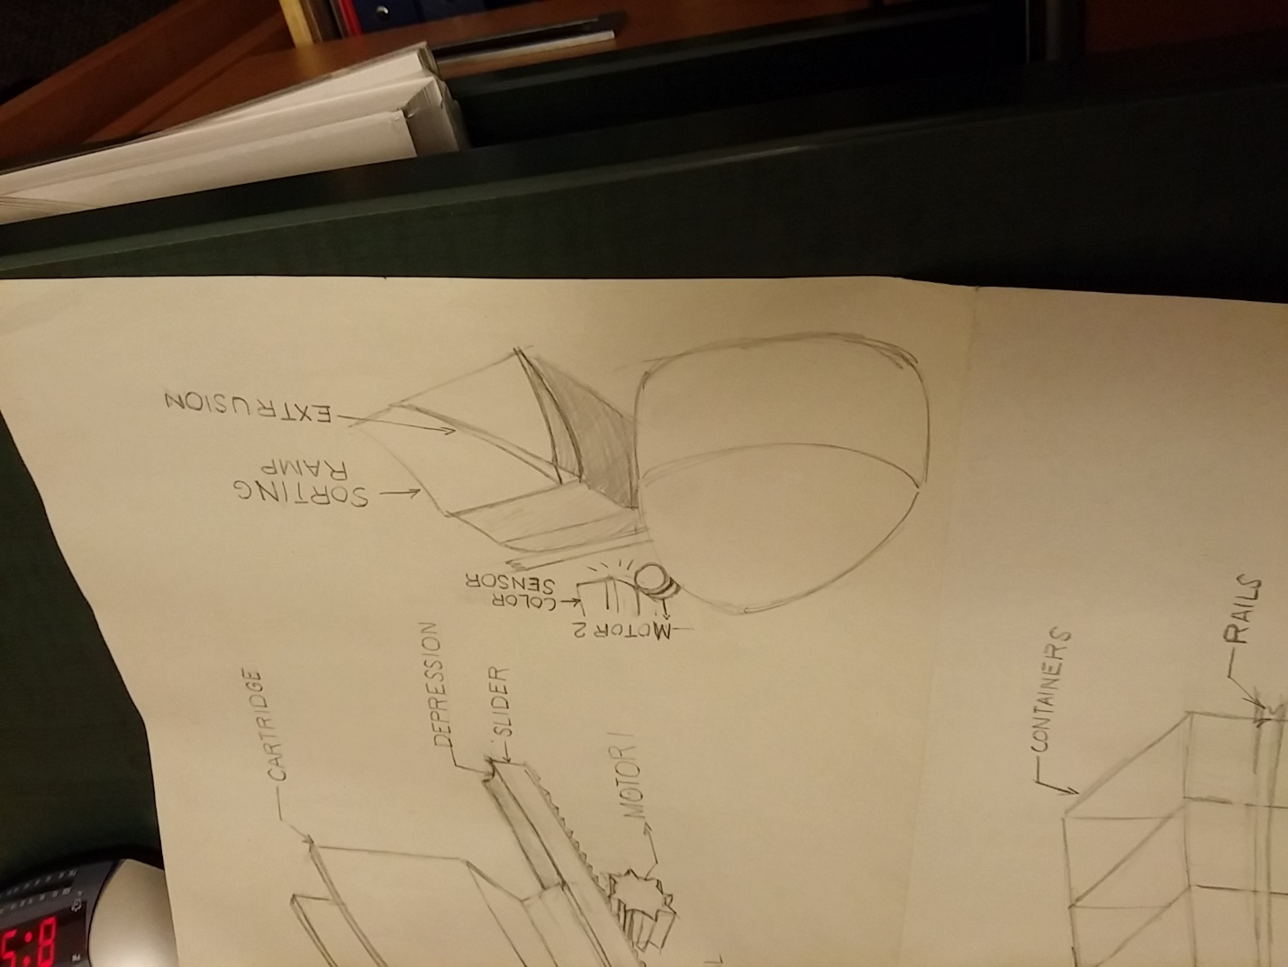
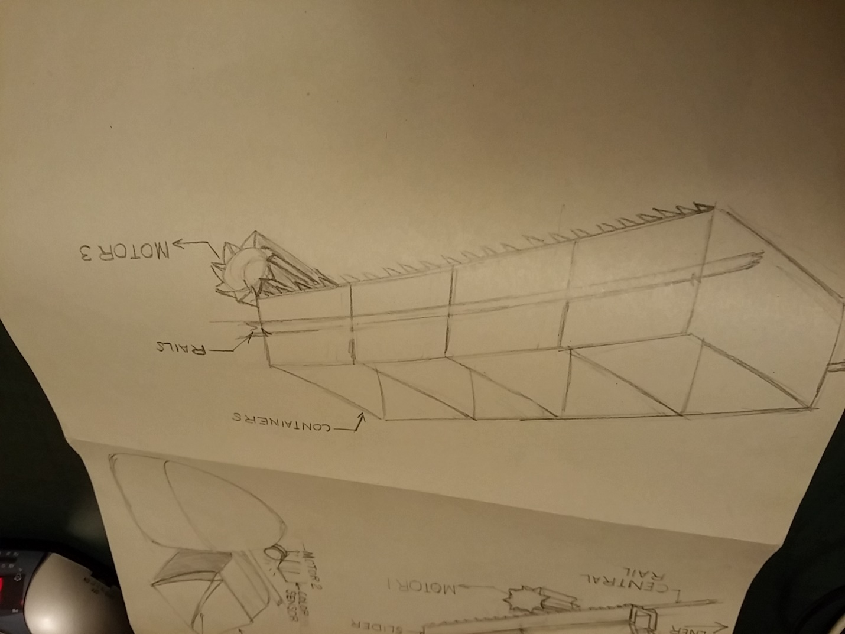
Preliminary Design 2
1
3
2
4
5

Slide 9
Final Design

Slide 10
Final Design – “Standard” (rough)

Slide 11
Verification of Specifications

